Slide 1
Scaling from 100M to 1T to 1B
W10 L1
Russel Dsouza / 2025-03-25

Slide 2
Recap
NLP so far
The Transformer Model
The Language Modelling Task
Pre-Training on an Internet-Scale Corpus
Fine-Tuning on Human Demonstrations
Instruction-Tuning with Human Feedback

Slide 3
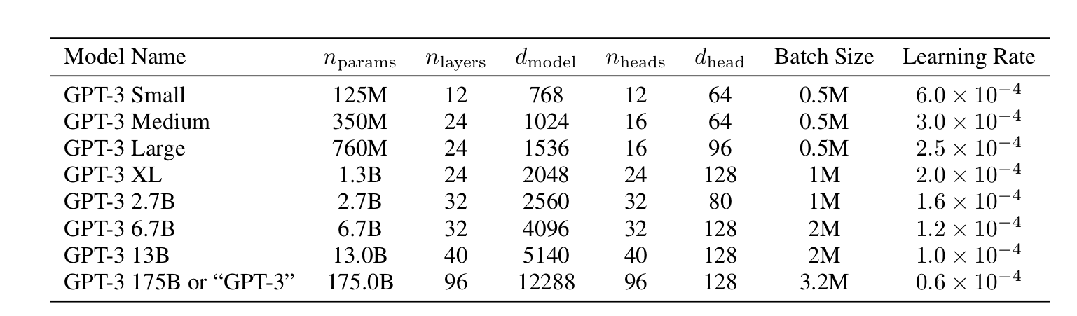
GPT2 to GPT3
124M to 175B

Slide 4
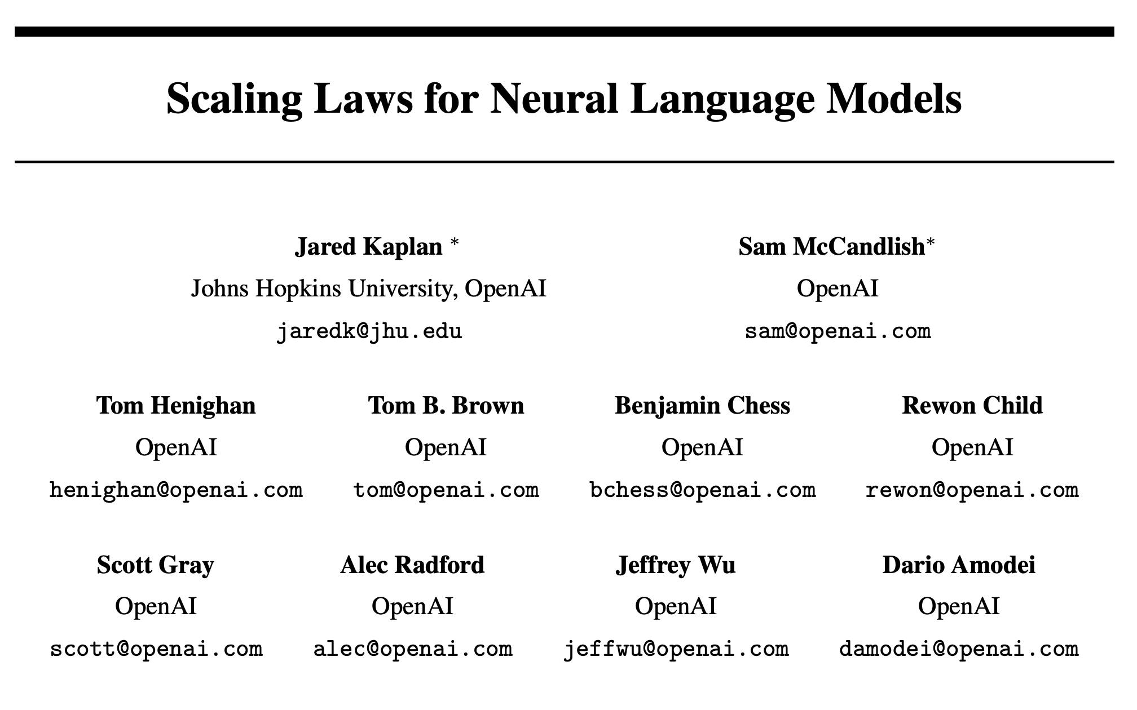
Scaling Laws, Kaplan et al., 2020
First paper of OpenAI’s golden year

Slide 5
Scaling Laws
What and Why?
Given a fixed compute budget, how should one trade-off model size and the number of training tokens?

Slide 6
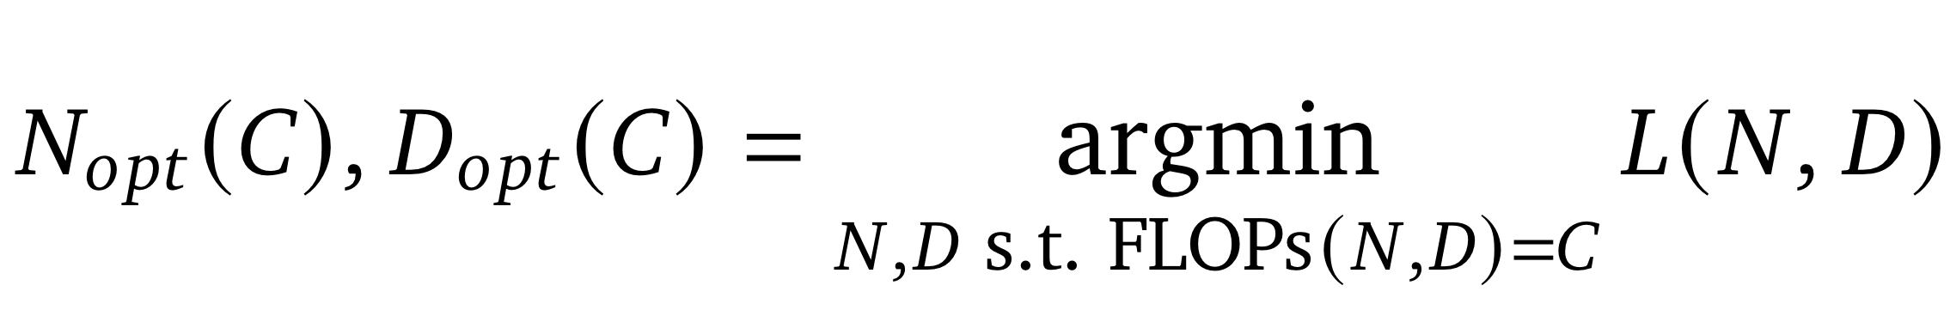
Scaling Laws, Kaplan et al. 2020
The task

Slide 7
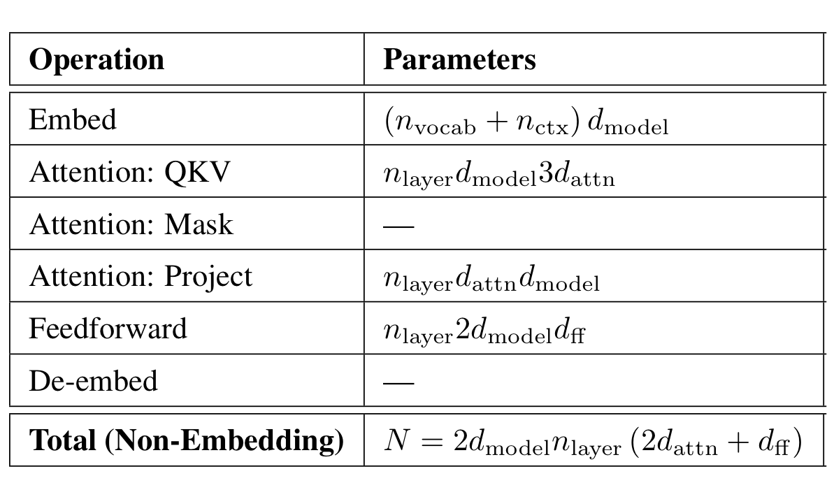
Scaling Laws, Kaplan et al. 2020
Estimating N

Slide 8
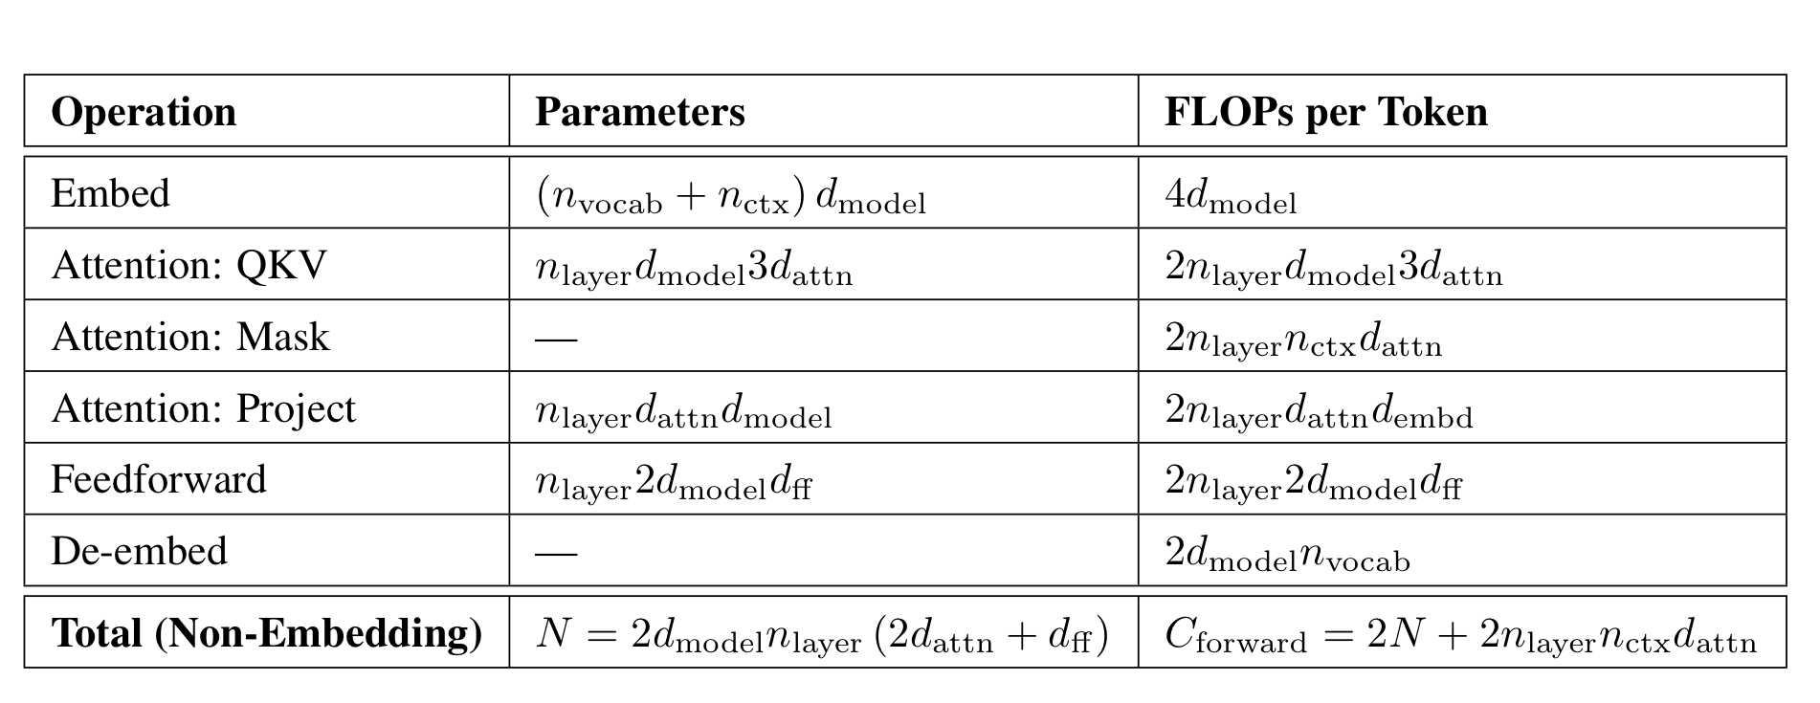
Scaling Laws, Kaplan et al. 2020
Estimating C

Slide 9
Scaling Laws, Kaplan et al. 2020
Estimating C

Slide 10
Scaling Laws, Kaplan et al. 2020
Back to the task

Slide 11
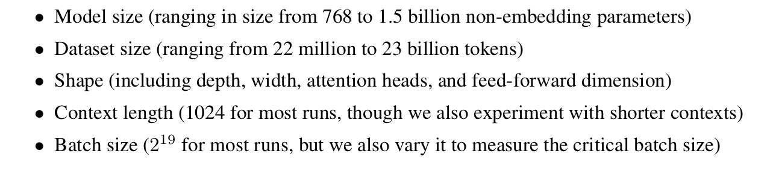
Scaling Laws, Kaplan et al. 2020
Experimental Setup

Slide 12
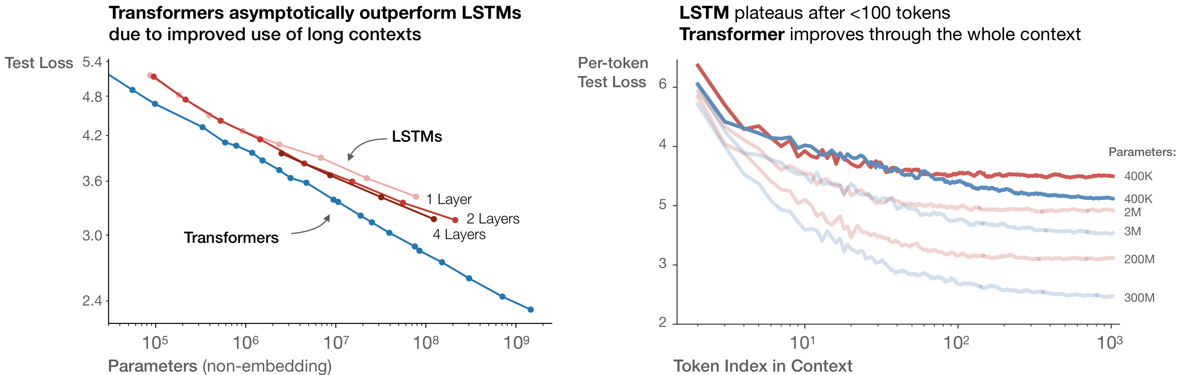
Scaling Laws, Kaplan et al. 2020
Effect of Architecture: Transformer vs LSTM

Slide 13
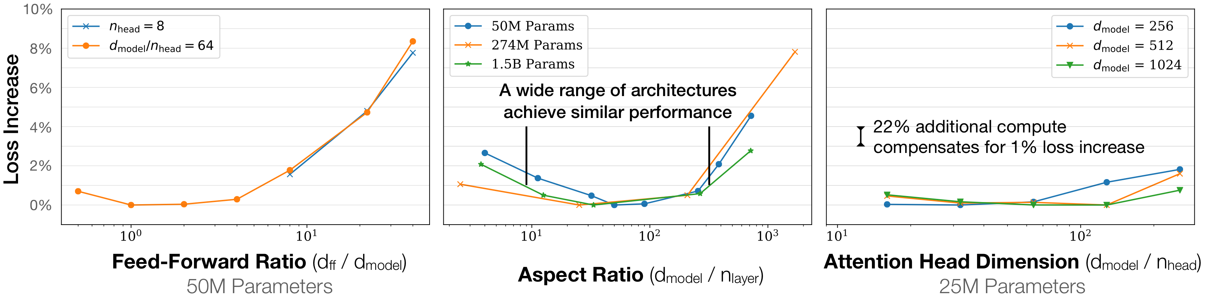
Scaling Laws, Kaplan et al. 2020
Effect of Model Shape

Slide 14
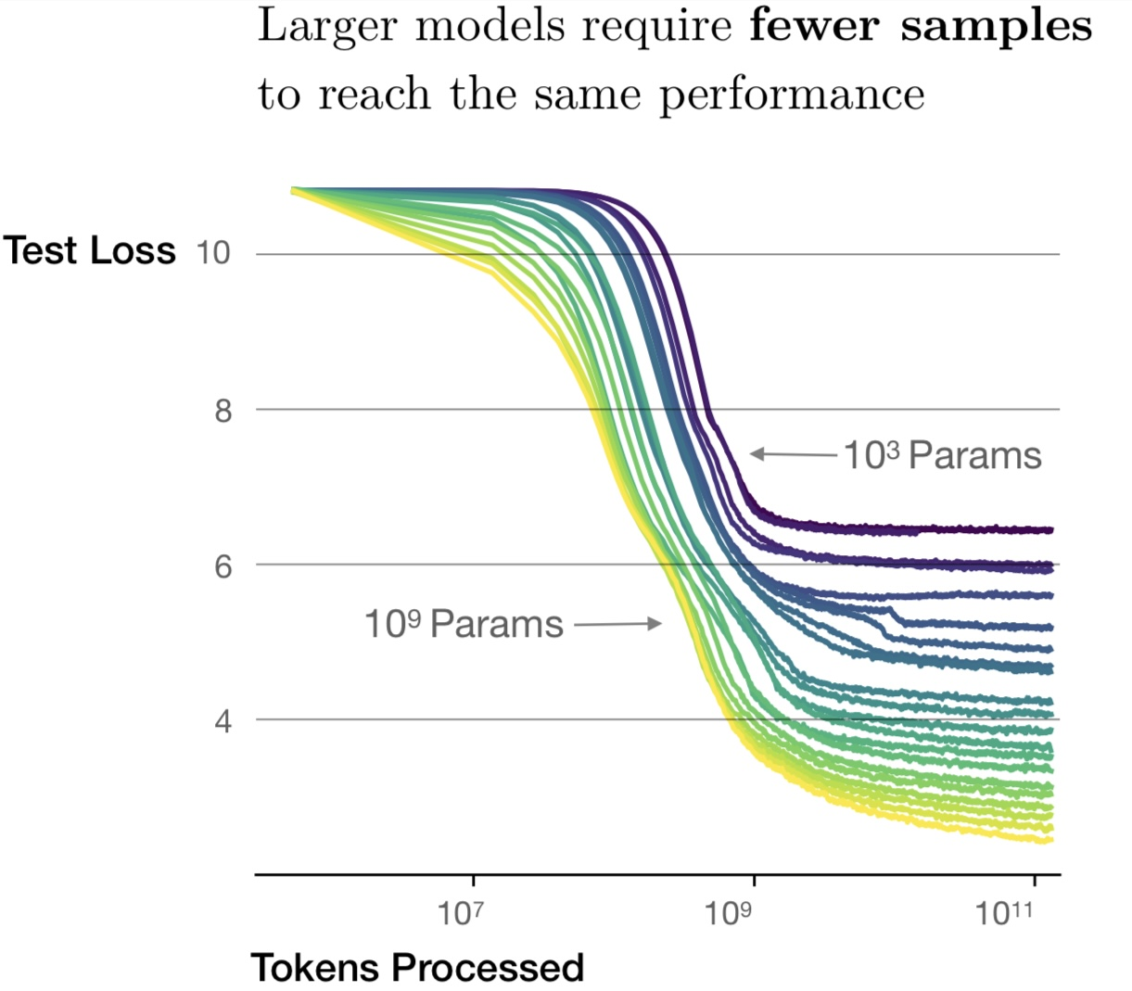
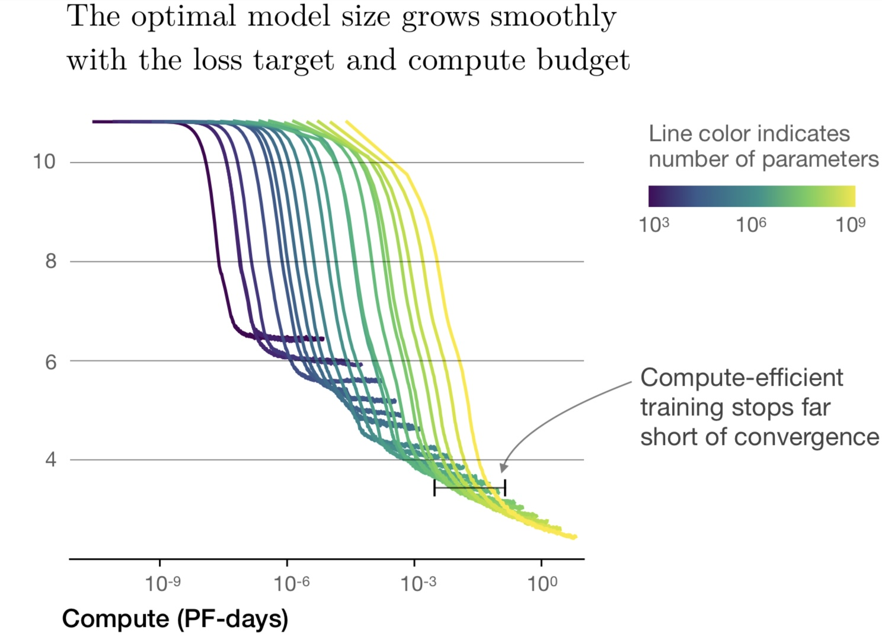
Scaling Laws, Kaplan et al. 2020
Sample Efficiency and Compute Efficiency

Slide 15
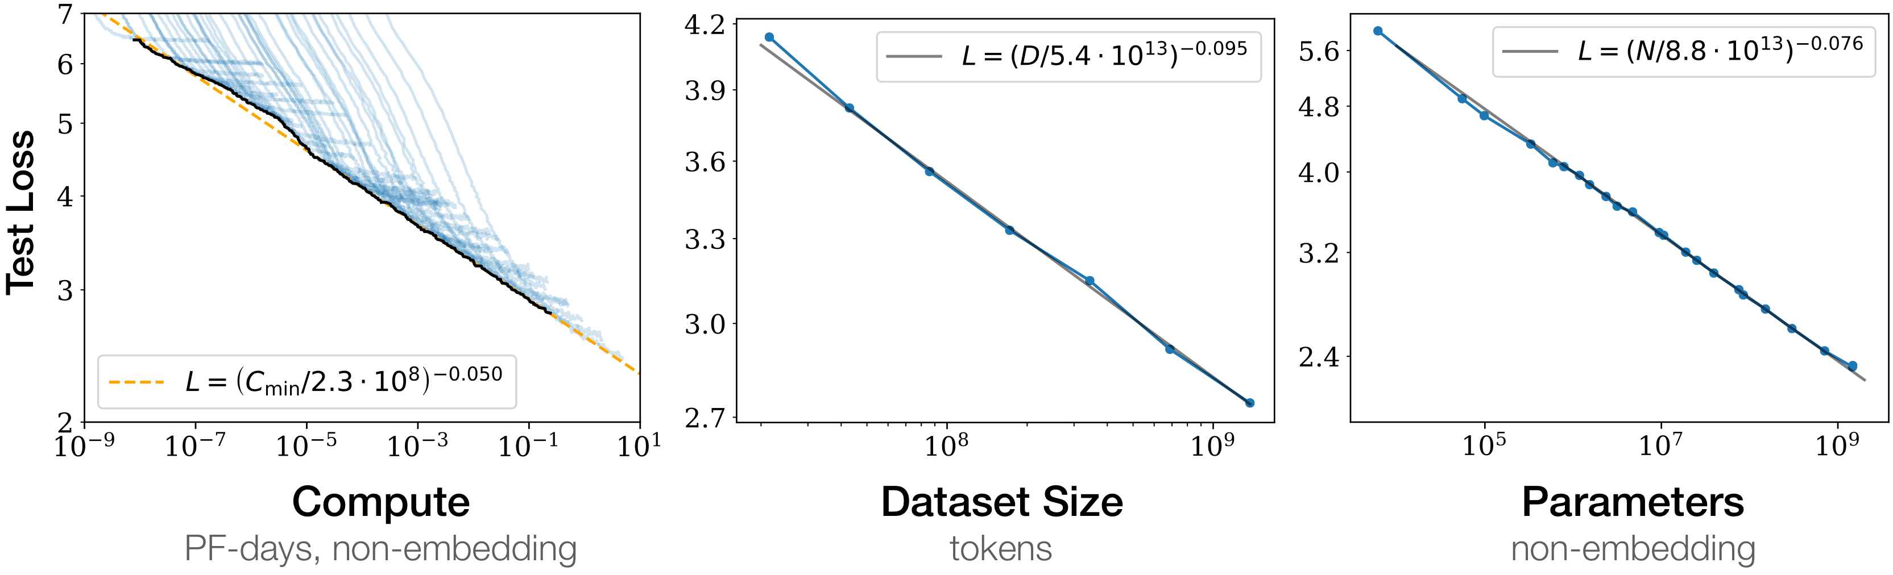
Scaling Laws, Kaplan et al. 2020
Power Laws

Slide 16
Scaling Laws, Kaplan et al. 2020
Power Laws

Slide 17
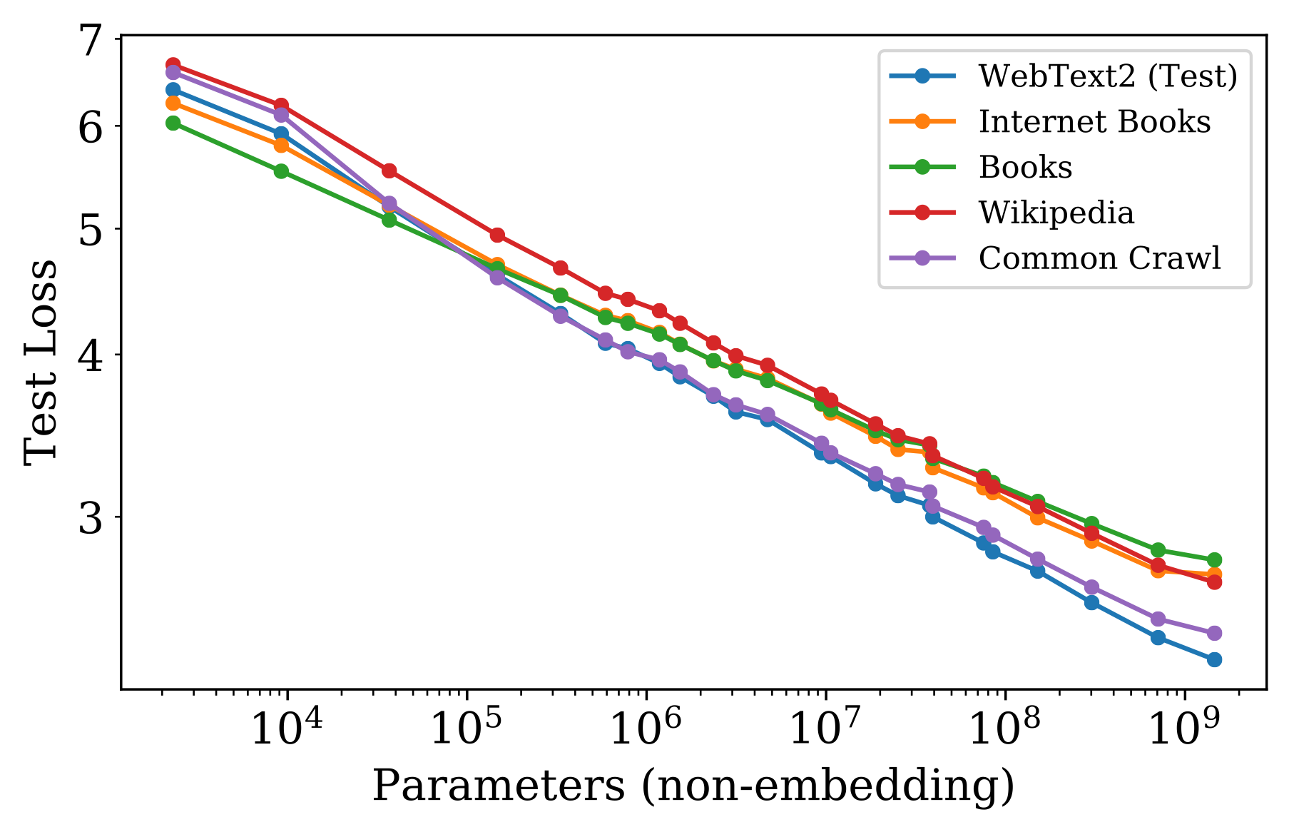
Scaling Laws, Kaplan et al. 2020
Results hold across datasets

Slide 18
Scaling Laws, Kaplan et al. 2020
Back to the task

Slide 19
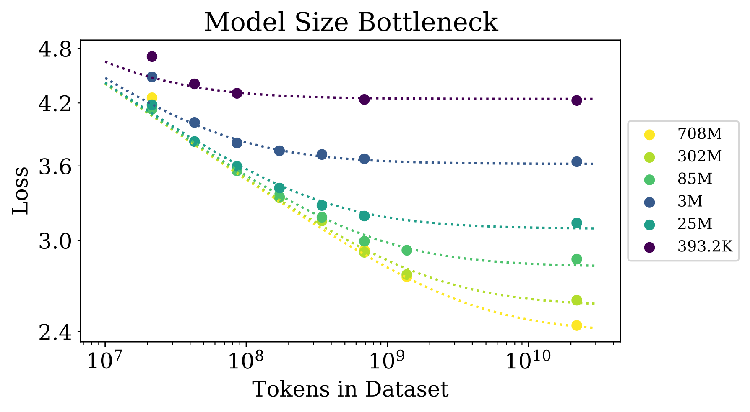
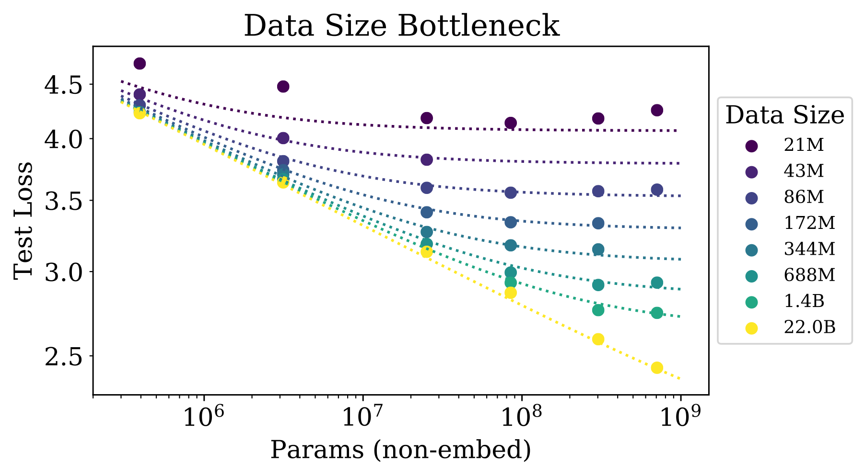
Scaling Laws, Kaplan et al. 2020
L(N, D)

Slide 20
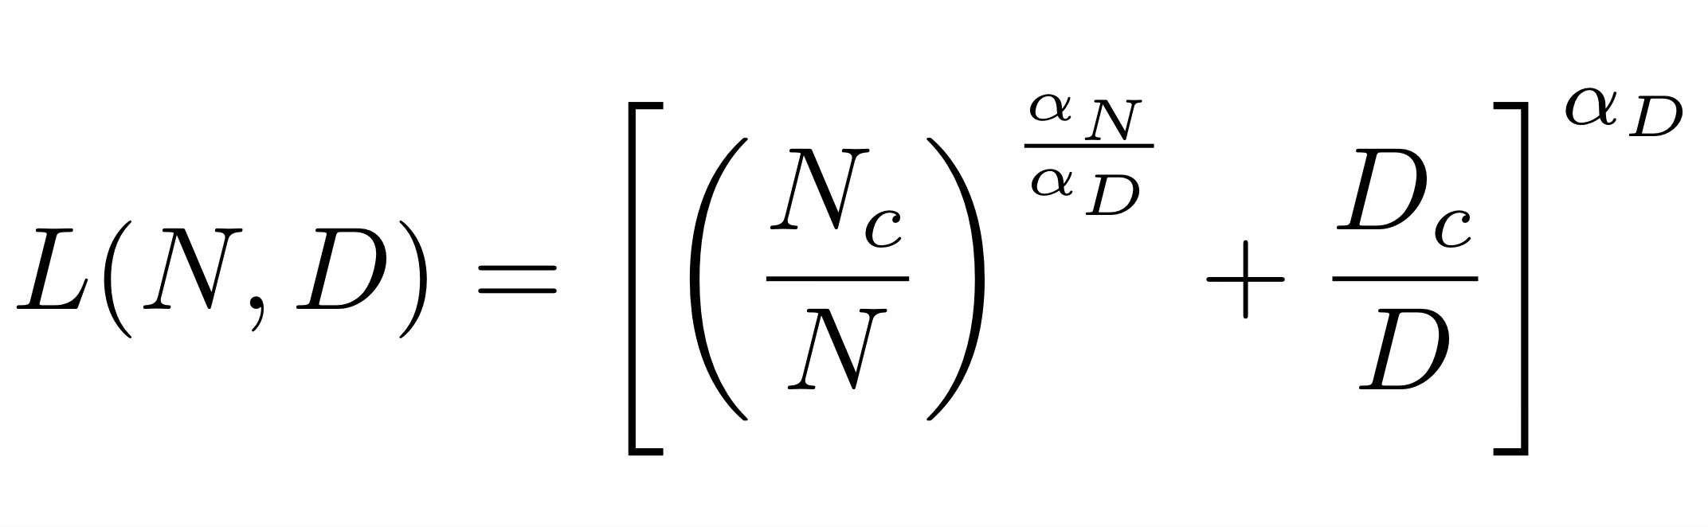
Scaling Laws, Kaplan et al. 2020
Another Power Law

Slide 21
Scaling Laws
Back to the What and Why?
Given a fixed compute budget, how should one trade-off model size and the number of training tokens?

Slide 22
Scaling Laws, Kaplan et al. 2020
Recommendations
As compute budget increases, the optimal allocation is larger models not more data or longer training.
For example, a 10x increase in compute should be allocated as:

Slide 23
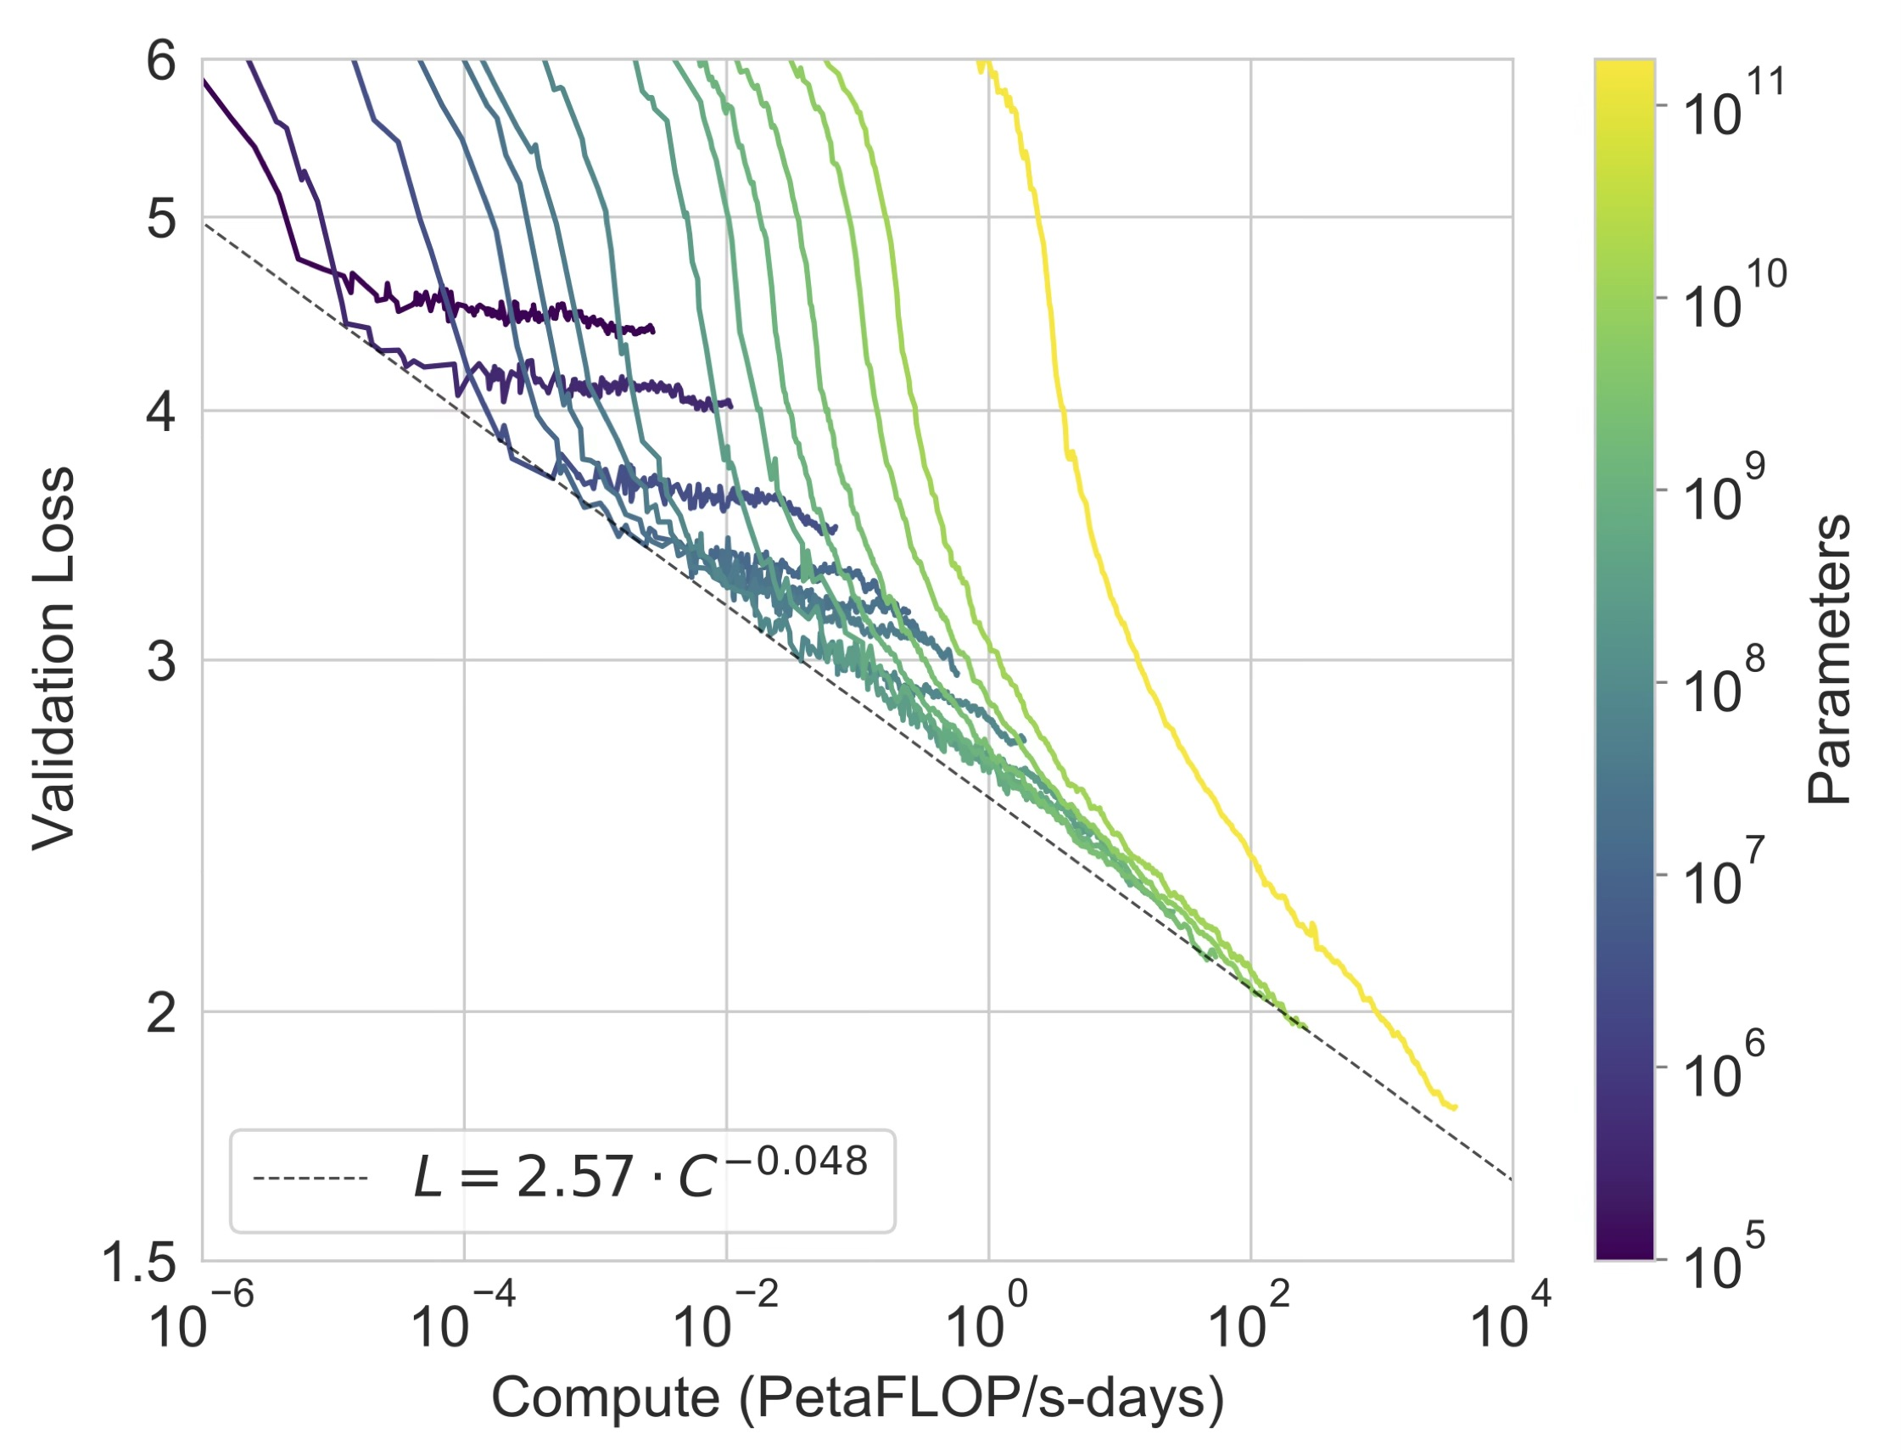
Scaling Laws
Where does GPT 3 fit in?

Slide 24
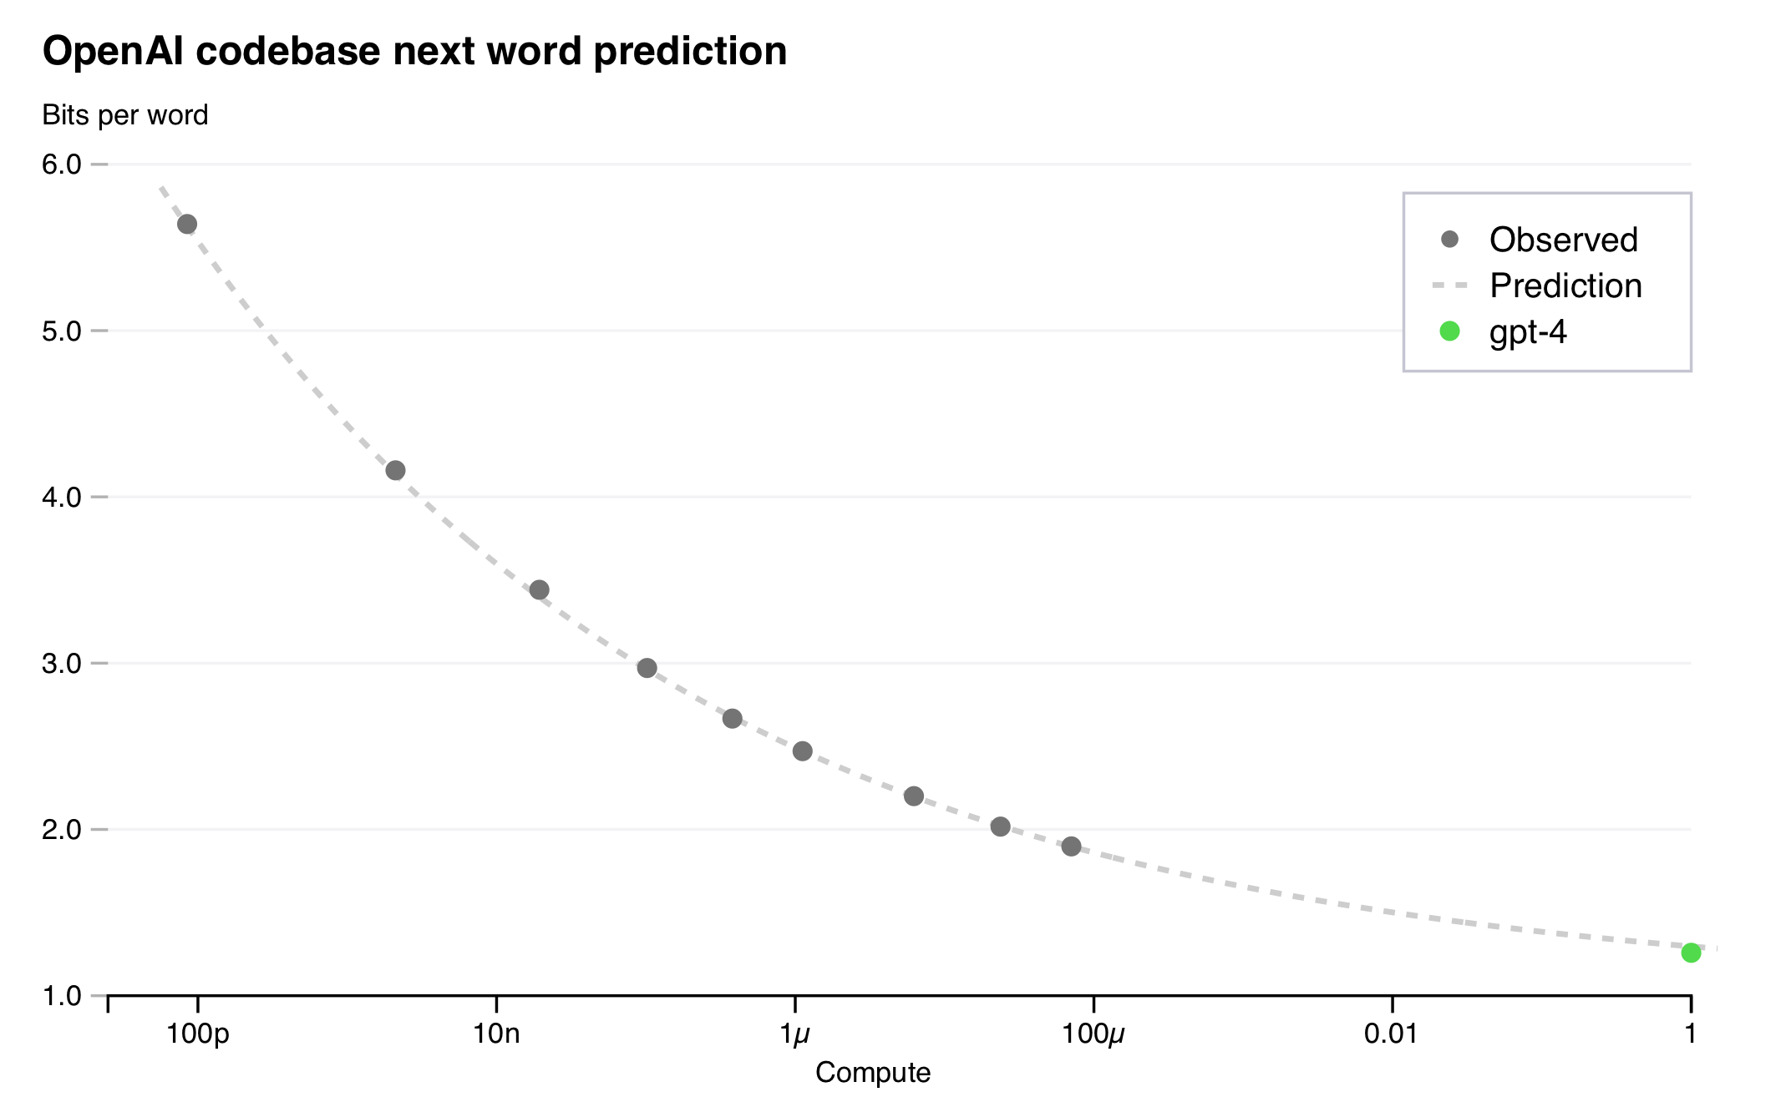
Scaling Laws
Where does GPT 4 fit in?

Slide 25
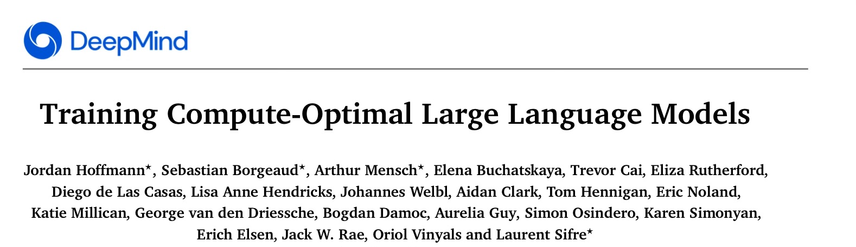
Scaling Laws, DeepMind 2022

Slide 26
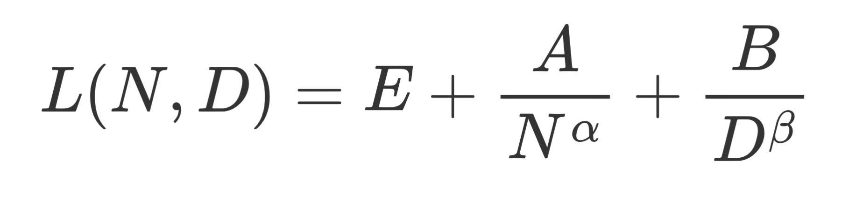
Scaling Laws, DeepMind 2022
Chinchilla Optimal

Slide 27
Scaling Laws, DeepMind 2022
Updated Recommendations
Scale model size and data size by equal proportions

Slide 28
Scaling Laws, DeepMind 2022
A New Task: Compute Overhead
If we reduce the optimal model size by half, by how much do we need to increase the number of training tokens to achieve the same model loss?
Is there a compute overhead?

Slide 29
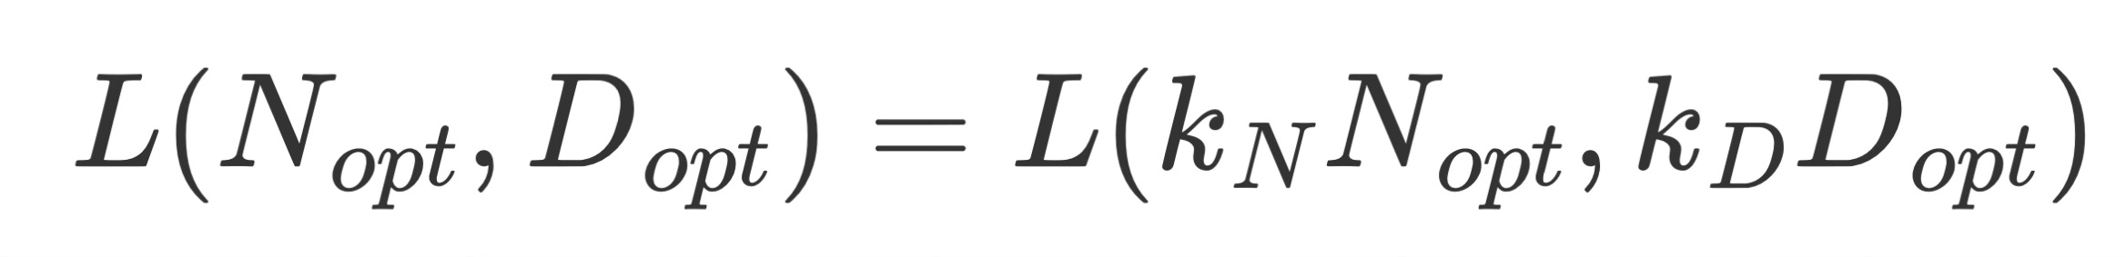
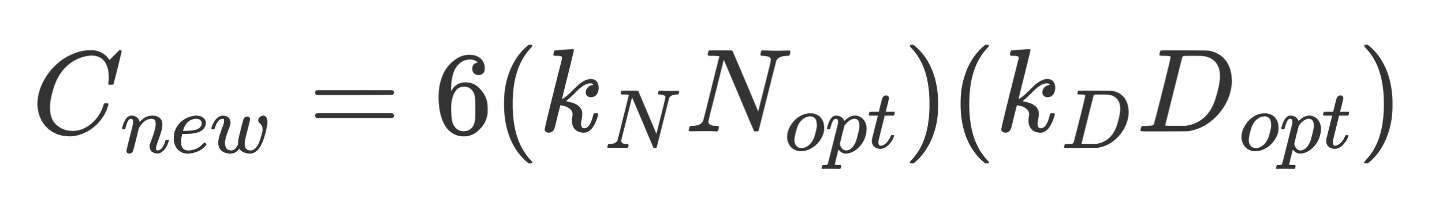
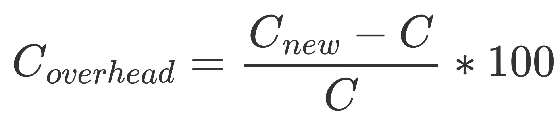
Scaling Laws, DeepMind 2022
Compute Overhead
Formally, we are looking to solve

Slide 30
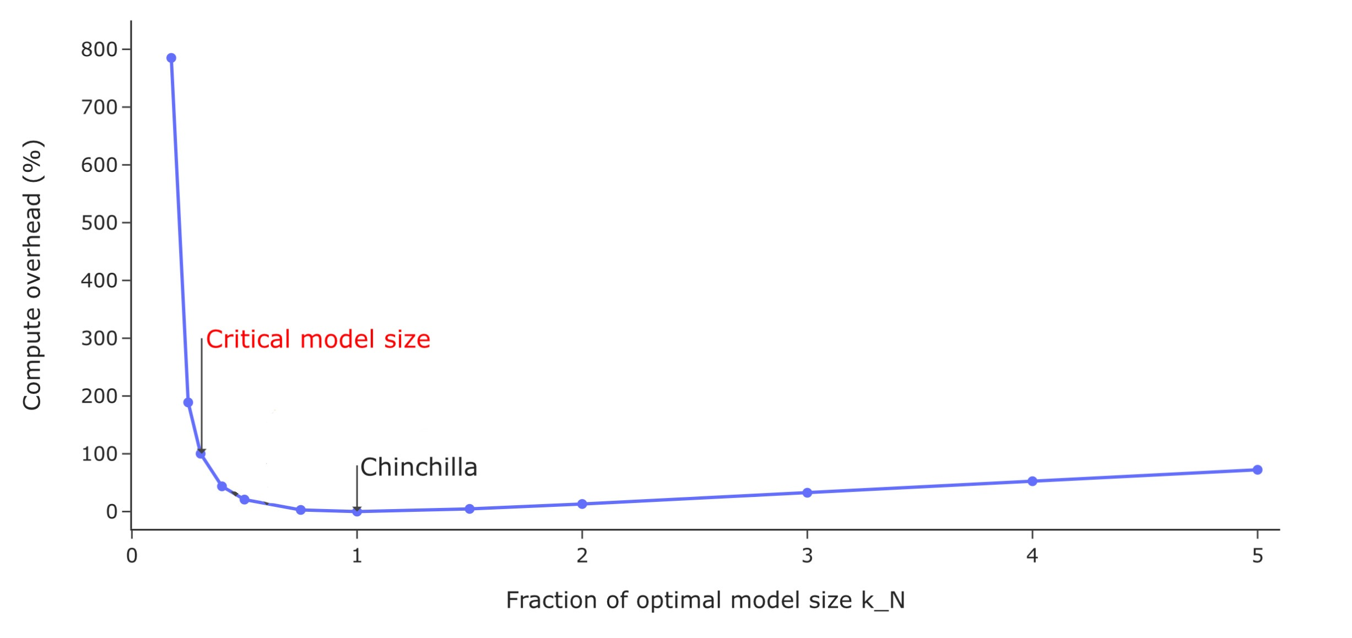
Beyond Chinchilla Optimal
Training-Inference Compute Trade-off

Slide 31
Llama 3
Beyond Chinchilla Optimal
While the Chinchilla-Optimal amount of training compute for an 8B parameter model corresponds to ~200B tokens, we found that model performance continues to improve even after the model is trained on 2 orders of magnitude more data.
Both our 8B and 70B parameter models continued to improve log-linearly after we trained them on up to 15T tokens.

